Slide 1
Green engineering. Interaction with green chemistry
Fyodor Malchik

Slide 2
GREEN CHEMISTRY
Green Chemistry is the utilization of a set of principles that reduces or eliminates the use or generation of hazardous substances in the design, manufacture and application of chemical products .
Green Chemistry is a recent approach to design of energy efficient processes and the best form of waste disposal.
The awareness among the organic chemists to practice green chemical routes for organic transformations is significantly increasing in the place of mineral acids, mild solid acids or clays are used. The reactions are carried out in organized media or in green solvents.
“We can’t solve problems by using the same kind of thinking we used when we created them “ - Albert Einstein

Slide 3
Green chemistry a tool
As human beings --- we are part of the environment
The way in which we interact with our environment influences the quality of our lives
Sustainable development the goal
Industrial ecology
Green
Chemistry
A tool
Green chemistry, lies at the heart of the industrial ecology

Slide 4
Green Chemistry Is About...
^{Waste}
^{Materials}
^{Hazard}
Reducing
^{Risk}
Energy
Cost

Slide 5
Examples of green chemistry
If the chemical reaction of the type
A + B P + W
Find alternate A or B to avoid W
Disinfection of water:
Disinfection of water by chlorination. Chlorine oxidizes the pathogens there by killing them, but at the same time forms harmful chlorinated compounds.
A remedy is to use another oxidant, such as
O₃ or supercritical water oxidation

Slide 6
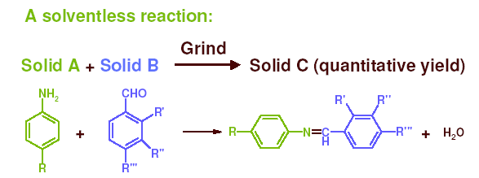
Use of auxiliary substances
“The use of auxiliary substances (e.g. solvents, separation agents, etc.) should be made unnecessary wherever possible, and innocuous when used”

Slide 7
Environmental Benefits
The total organic waste for the reduction step will be reduced by 3.4 million L / annum (65% reduction)
Liquid Nitrogen usage of 3 million L / annum is eliminated
Large Savings in energy use and processing time.

